Slide 1

Total Differentials

Slide 2
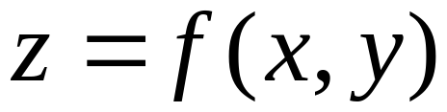


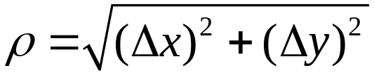



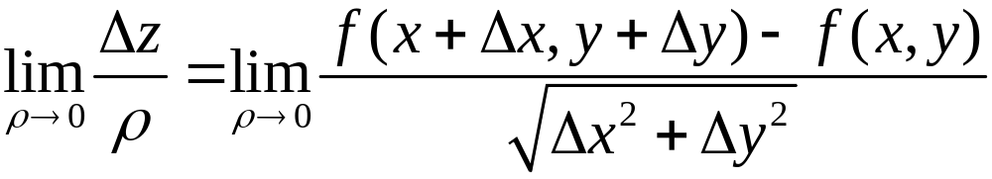
这样去定义二元函数的可微好吗 ？

Slide 3
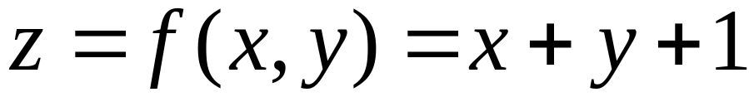
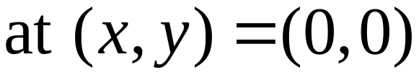
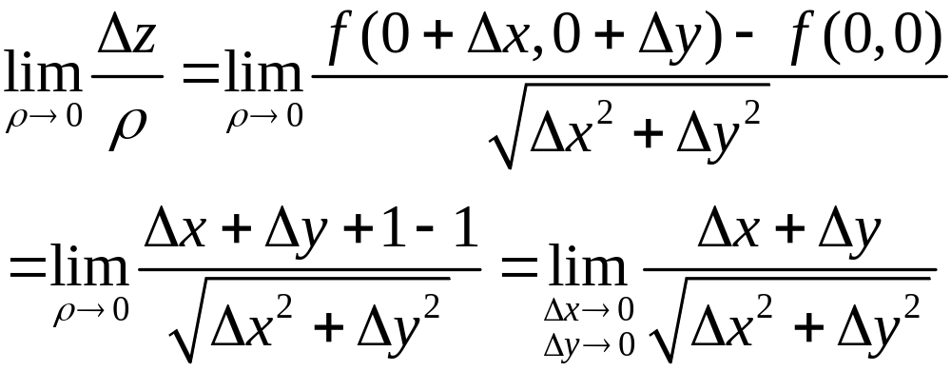
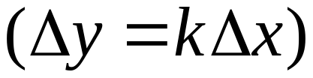
Let
极限不存在，连平面都不可微分，这定义不好。

Slide 4
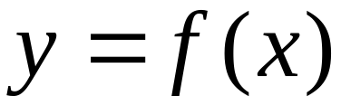
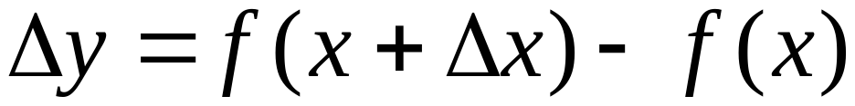
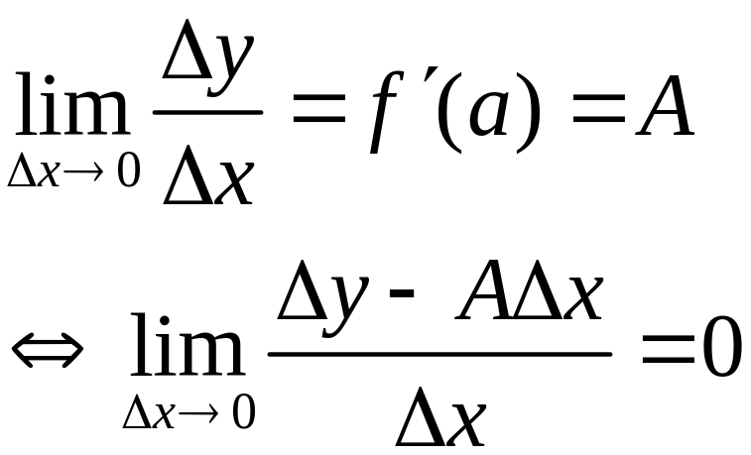
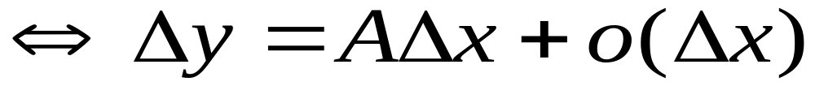
Recall: Linearization
y = f(x) is differentiable at a if and only if
Linear part

Slide 5
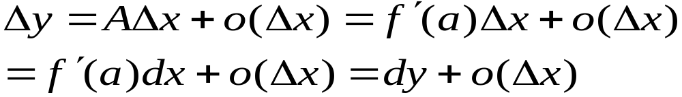
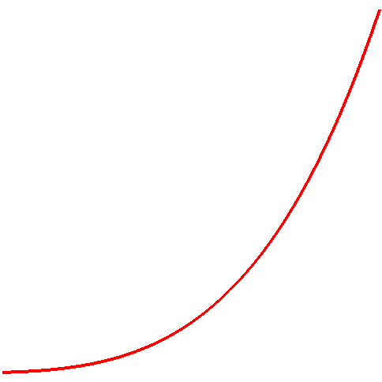
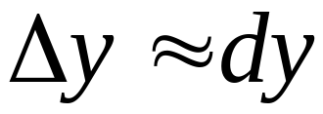



Geometric interpretation of linearization
tangent line
plot(x^4-x^2+2,x=1..4,axes=none,thickness=4);

Slide 6
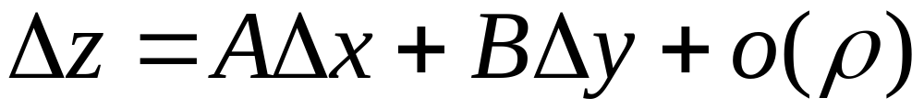

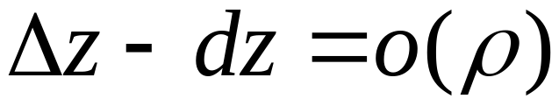
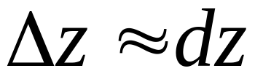
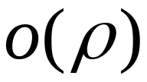
Linearization for functions of two variables
increment in z
z = f(x, y) 在 (a, b) is differentiable if there are A, B
Linear part
Total differentiable：
Error：

Slide 7

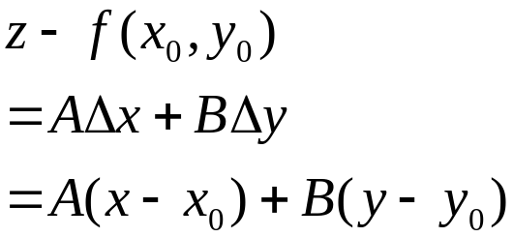





Geometric Interpretation
tangent plane
with(plots):
qumian:=plot3d([abs(y)*cos(t),abs(y)*sin(t),y^2],y=-1..1,t=0..2*Pi,grid=[30,30]):
quxian:=plot3d([0,y,y^2],y=-1.2..1.2,z=0..2,thickness=3,color=red):
display(qumian,orientation=[23,78],scaling=constrained);

Slide 8
Geometric interpretation of linearization
Linear (plane) approximation

Slide 9
A、B depend only on the point (a, b)
What are the constants A and B?

Slide 10
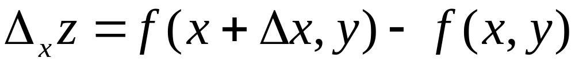
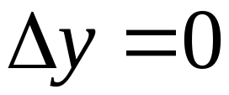
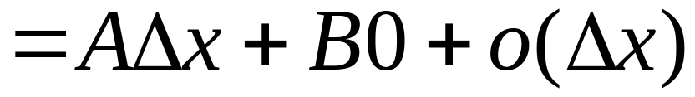
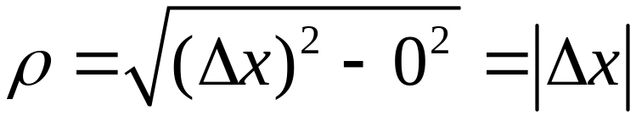
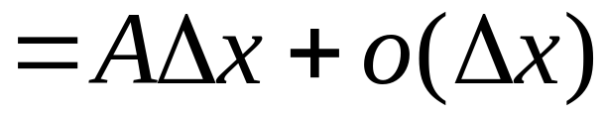
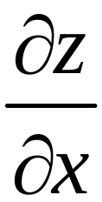
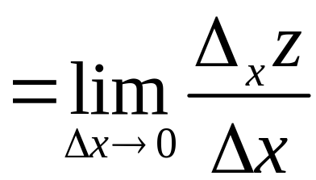
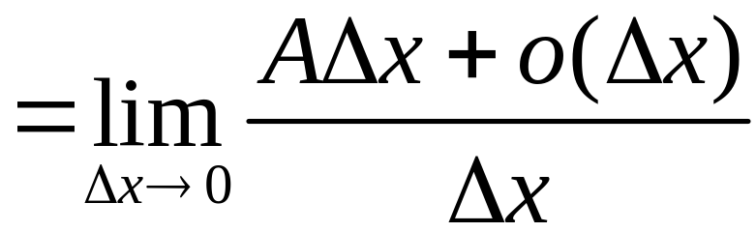
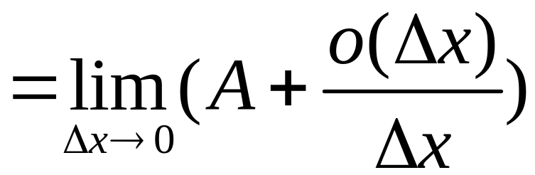

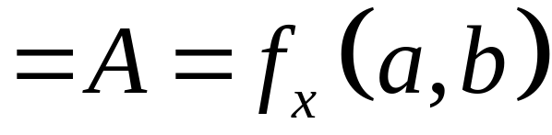
If differentiable
In particular

Slide 11
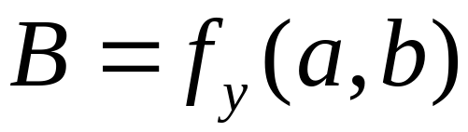
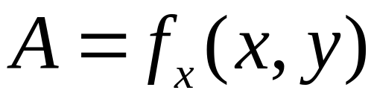
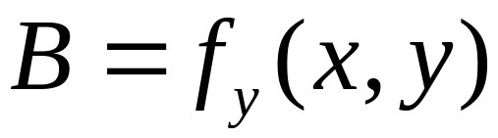
Similarly ，
So we proved
Theorem (a necessary condition for differentiability）
If f(x, y) is differentiable at (x, y) then the two partial derivatives at (x, y) exists. And

Slide 12
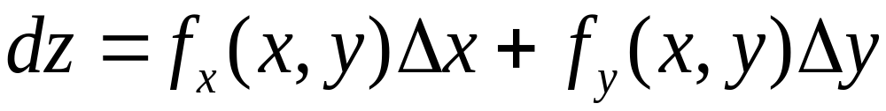

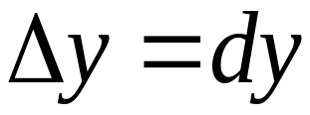
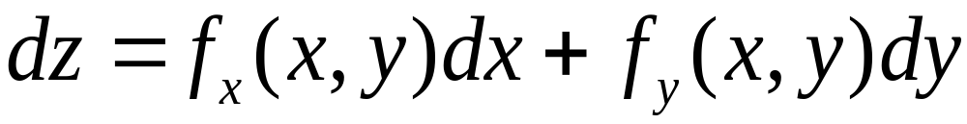
Total differential

Slide 13
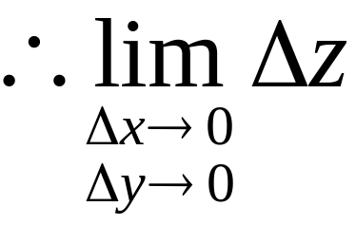
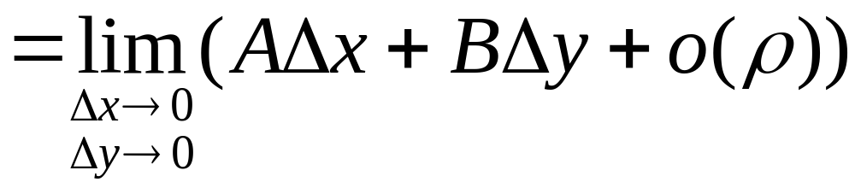

Differentiability implies continuity
Theorem
f(x, y) is differentiable at (x, y) then f(x, y) is continuous there
Proof
differentiable：
So, it is continuous at (x, y)

Slide 14
A sufficient condition of differentiability
Theorem (sufficient condition）
The two partial derivatives of f(x, y), f_{x}(x, y) and f_{y}(x, y) are continuous at (x, y), then f(x, y) is differentiable at (x, y)

Slide 15
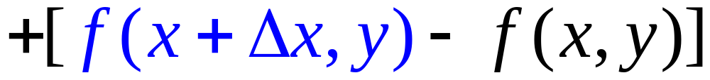
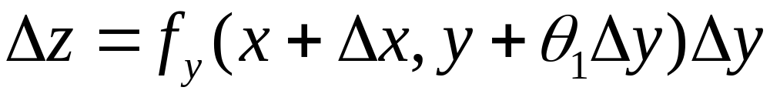
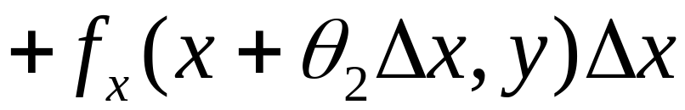
Proof
And so
Applying Lagrange Mean Value Theorem
（Recall ）

Slide 16

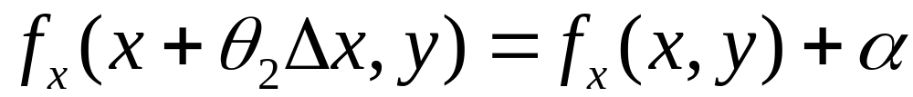
Since f_{x}(x, y) and f_{y}(x, y) are continuous

Slide 17
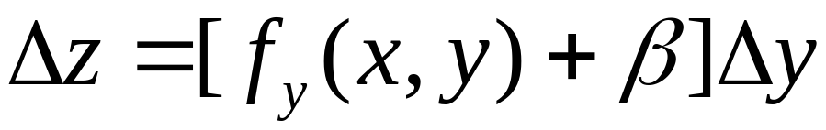
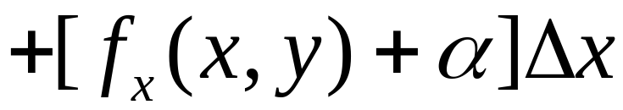

Slide 18
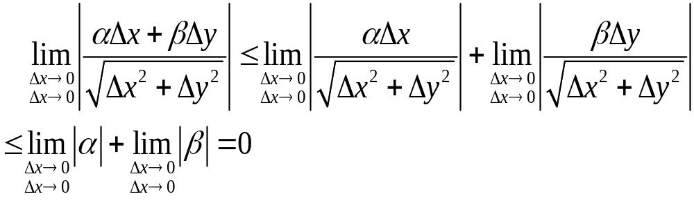
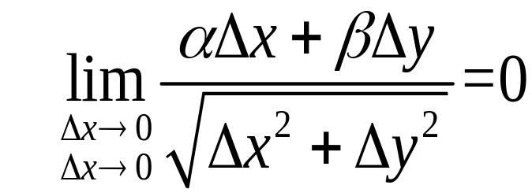

z= f(x, y) is differentiable at (x, y)

Slide 19
Partials are continuous is a sufficient but not a necessary condition
There are examples showing that a function differentiable but the partials may not be continuous.

Slide 20
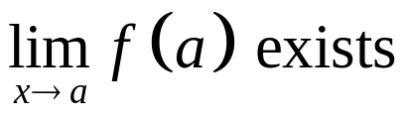
Function of one variable
differentiable
f′(a) exist
Continuous at x=a

Slide 21

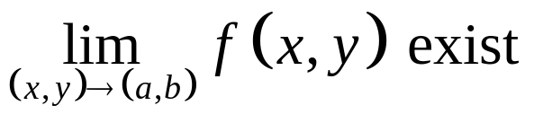
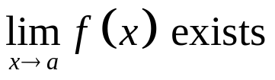
Functions of several variables, at a certain point (a, b)
Partials are continuous
differentiable
Partials exist
Functions of one variable at x=a
continuous
differentiable
continuous
Try to find counterexamples for each red cross

Slide 22
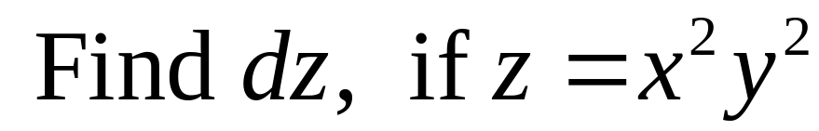
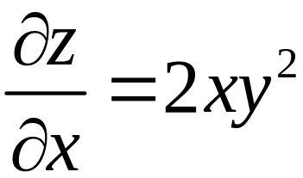




Example
solution

Slide 23











Example
Solution

Slide 24


z= f(x, y) is differentiable at (a, b)

Slide 25






Example
(i) Is f continuous at (0,0)?
(ii) Find and if they exist
(iii) Is f differentiable at (0,0)?
(i)
So, f is continuous at (0,0)

Slide 26


Example
(ii) Find and if they exist
(ii)

Slide 27



Example
(iii) Is f differentiable at (0,0)?

Slide 28




Example
(iii) Is f differentiable at (0,0)?
Along ,
So, f is NOT differentiable at (0,0).
Then,

Slide 29



Sensitivity

Slide 30


Slide 31










Estimate

Slide 32














Not
too bad！
Good？

Slide 33







Functions of several variables
Gradient is similar to derivative
So, to some extent
Vector form
compare

Slide 34








Example
Solution

Slide 35





Example
Solution 1

Slide 36




Example
Solution 2

Slide 37



Exercise
1. Find total differential of
at
2. Find total differential of

Slide 38


1. Find total differential of
at
Answer:
2. Find total differential of
Answer:

Slide 39
END

